Slide 1
What is eating sustainably?

Slide 2
The following is a quick quiz on diet and food choices. Keep score as we go through the following slides
taken from Smith, Alice. 2015. (Ontario Secondary School Teachers Federation). Socially-based Curriculum Unit:
My Eco-Footprint: Human Impact on the Environment
Diet and Food Choices
Questions # 1 to 5:
A = 1 point
B = 2 points
C = 3 points
D = 4 points
E = 5 points

Slide 3
Question 1:
How often do you eat meat or other animal products
(i.e. milk, cheese, eggs)?
Never. I’m vegan.
I don’t eat meat or eggs at all but I eat some dairy products.
I don’t eat meat, but I do eat eggs and dairy products.
I eat meat and other animal products several times a week.
I eat meat and other animal products every day.

Slide 4
Question 2:
How often do you eat fast food or eat out
(this includes the school cafeteria)?
Never
Rarely (a couple of times a month).
Occasionally (once or twice a week).
Often (a few times a week).
Almost every day or every day.

Slide 5
Question 3:
How often do you eat processed foods
(i.e. frozen foods or prepackaged foods)?
Never
Rarely (a couple of times a month).
Occasionally (once or twice a week).
Often (a few times a week).
Almost every day or every day.

Slide 6
Question 4:
How often do you try to buy food that you know was produced or grown locally?
Never
Rarely (a couple of times a month).
Occasionally (once or twice a week)
Often (a few times a week).
Almost every day or every day.

Slide 7
Question 5:
How often do you drink bottled water?
Never, I use a refillable water bottle.
Rarely (a couple of times a month).
Occasionally (once or twice a week).
Often (almost every day).
I drink more than one bottle a day.

Slide 8
Wrap up to quiz
Diet and Food Choices
Questions # 1 to 5:
A = 1 point
B = 2 points
C = 3 points
D = 4 points
E = 5 points
THINK, PAIR, SHARE
Think about your result.
Share one thing you learned while going through this exercise.
What would a sustainable food choice look like?

Slide 9
Explore: Class assignment
Divide the class into smaller groups and research what is a sustainable food choice. Using the the handout write down what how your food choices affect (People, Profit and Planet). This powerpoint has a number of articles and ideas to assist the groups as they work through the three areas. Ask that each group have a person that will write down the groups responses and bring it back to the larger group.

Slide 10
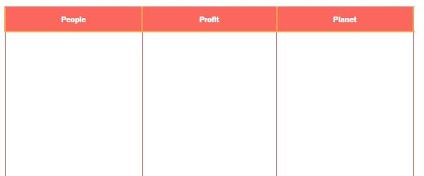
U2L2A3| Sustainable food choice
Overview
This activity will help you discover what are some of the things to consider when making a sustainable food choice by researching sustainability in regards to planet, profit and people.

Slide 11
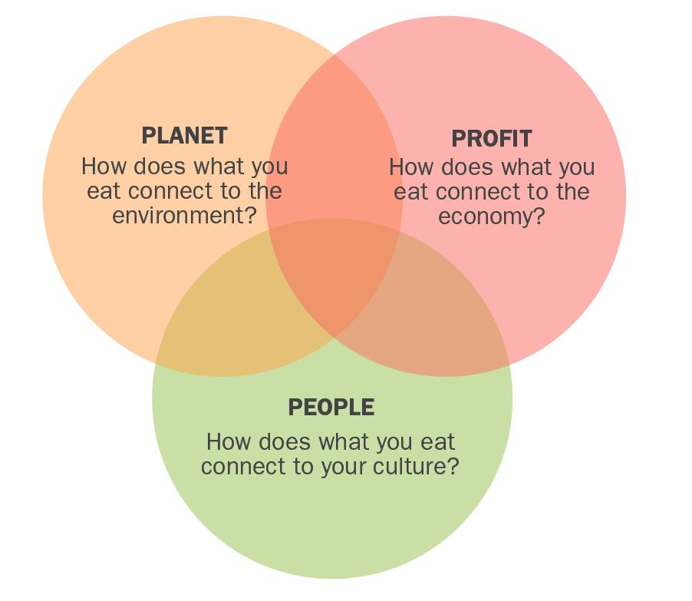

Slide 12
Planet - Environmental
What are the impacts of the food you select on the environment?
Draw up a list of environmental impacts that you would need to consider from when the food starts at the farm until it ends on your plate.
Articles
Forget fad diets: sustainable food is healthier and more eco-friendly by Tess Riley http://www.theguardian.com/education/2015/jan/22/forget-fad-diets-sustainable-food-is-healthier-and-more-eco-friendly
Eat Green: Our everyday food choices affect global warming and the environment by Jonathan Kaplan
http://www.nrdc.org/globalWarming/files/eatgreenfs_feb2010.pdf

Slide 13
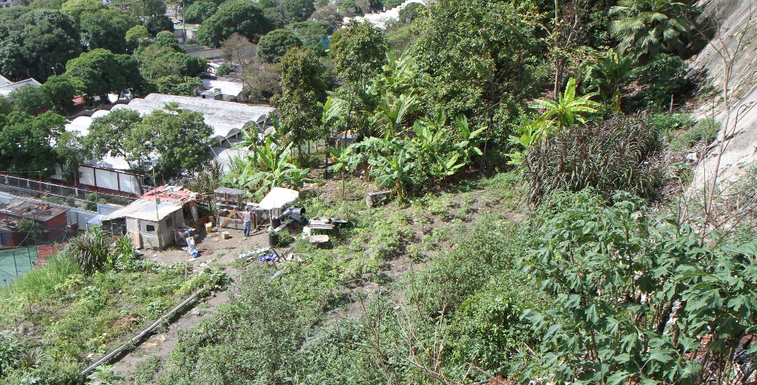
Some consideration about your food choice and the planet
How much energy was used?
How much water was needed?
What chemicals were used?
Where did the seeds come from?
Food wastage?
How far does the food travels?
Type of farming practice: organic, conventional? Small verses large scale?

Slide 14
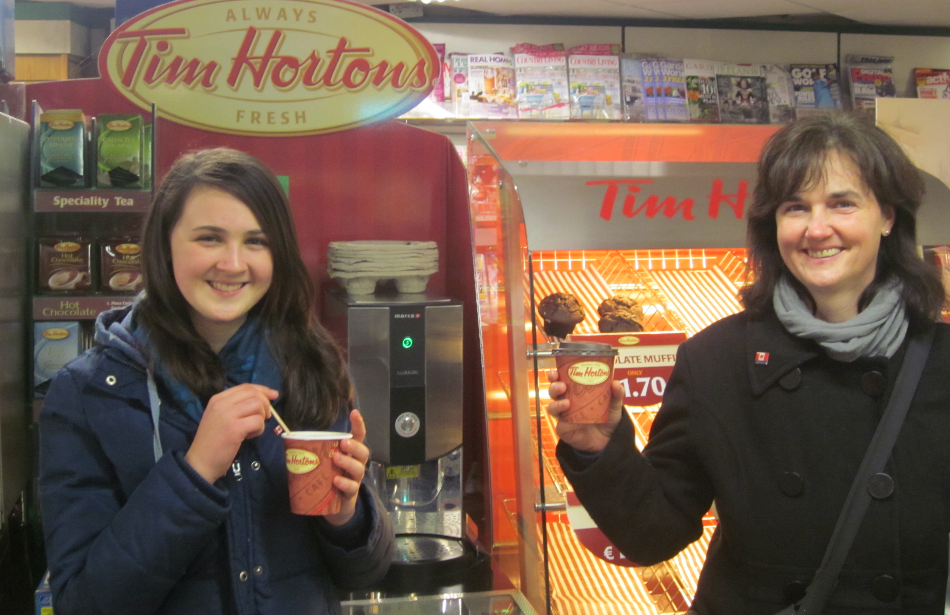
People - Cultural or community
What foods do you select based on your culture?
Write down some of the impacts of your food choice based on your community?
Video Sharing the Harvest – A Retailer describes why she loves organic by the OrganicCouncilOntario video:
www.youtube.com/watch?v=L_FI8AZIcwA

Slide 15
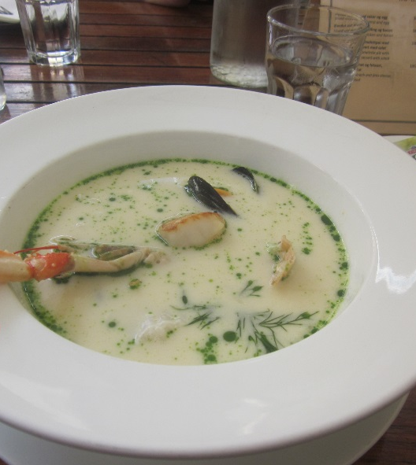
Some considerations about your food choice and the community
Are your food choices based on your culture?
Are the foods local food or Imported?
Any issues around accessing food?
What are the nutritional implications of your food choice?
How does it fit into the Canadian Food Guide?
What are your personal preferences in selecting foods?

Slide 16
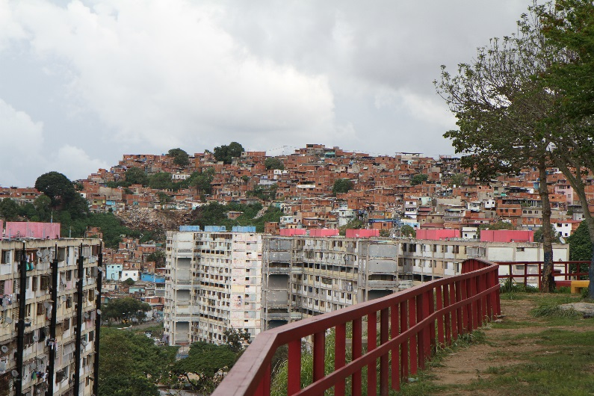
Profit—Financing your
food and its implications
What are the impacts of the food you select on the economy?
Draw up a list of financial concerns when it comes to your food choices.
Articles
33 Ways to Eat Environmentally Friendly by Laura Newcomer
healthland.time.com/2012/08/24/33-ways-to-eat-environmentally-friendly/
Why Food Sustainability Matters and 10 Things You Can Do About It by Laura
www.simplebites.net/10-tips-for-sustainable-eating/

Slide 17
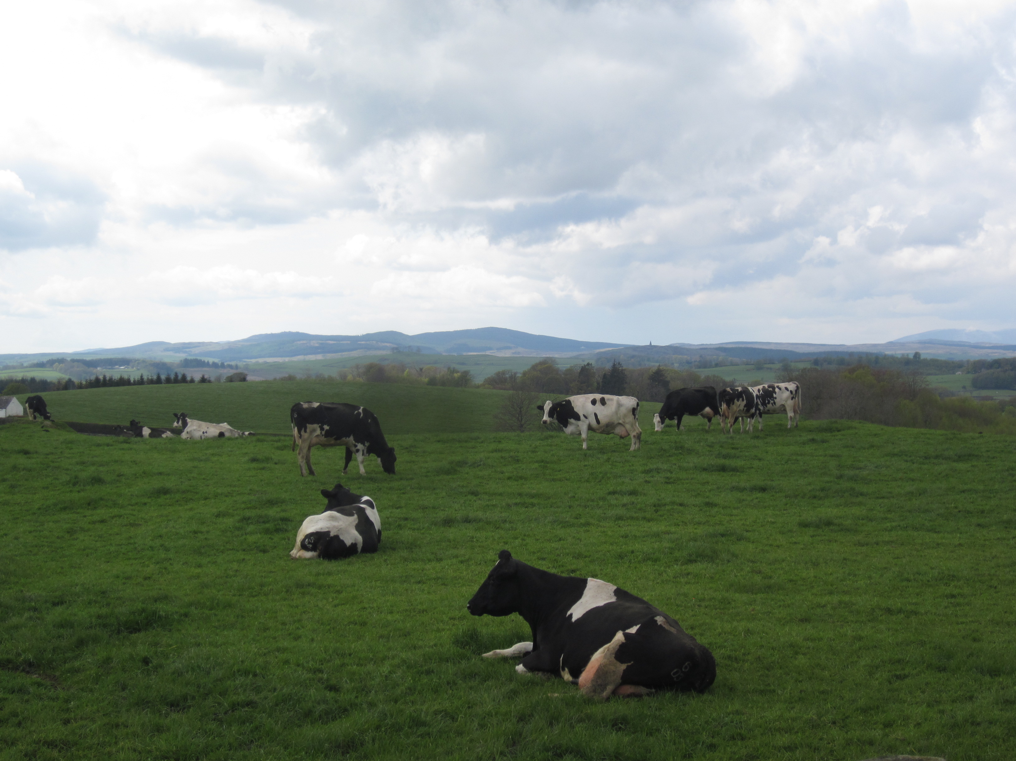
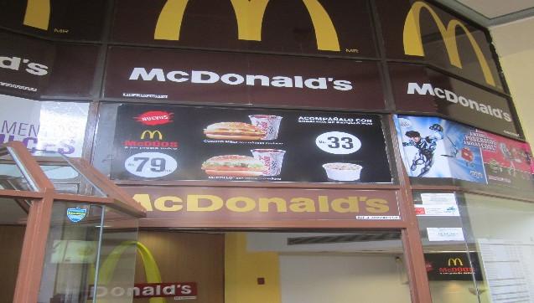
Some consideration about your food choice and profit
What are food cost? Who gets the profit?
Local vs. global grower and distributor.
Supply and demand of food.
Is the food subsidized?
Exchange rates and the cost of food.

Slide 18
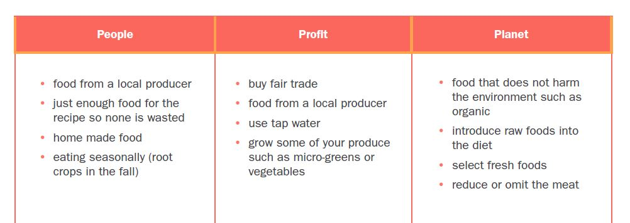
Sharing
Discuss as a large class the findings on “What is a sustainable food choice? “

Slide 19
Analyze questions
Complete the final question on the worksheet
What have I learned about selecting foods that are sustainable?

Slide 20
Sustainable menu activity
Based on where you live and the time of the year, list a number of foods that are sustainable. From this list, look up recipes that would work in creating a sustainable menu.

