Slide 1
What is art?
An introduction to the concept of art

Slide 2
On your own, contemplate the following questions
1. How do you define art?
2. Why do you feel your definition encompasses all that art is?

Slide 3
Now, in small groups share your definitions of art. Then as a group answer the following questions:
How are your definitions of art different?
As a group try to define art?

Slide 4
What is art?
The definition of art is, and has been, hotly debated.
How did your group define art?
Is it possible to create one definition of art? Explain.

Slide 5
What are the elements of art?
The elements of art are the building blocks of a piece of art.
Just as atoms form together to make a molecule, these elements form together to make a work of art.

Slide 6
What are the elements of art?
The main elements are:
Line
Shape
Form
Space
Artists manipulate these elements, mix them in with principles of design and compose a piece of art.
Not every work has all these elements, but will always have at least two present.
Texture
Value
Colour

Slide 7
Why are the elements of art important?
A person can't create art without utilizing at least a few of them. No elements, no art, end of story.
Knowing what the elements of art are enables us to:
Describe what an artist has done,
Analyze what is going on in a particular piece
Communicate our thoughts and findings using a common language.

Slide 8
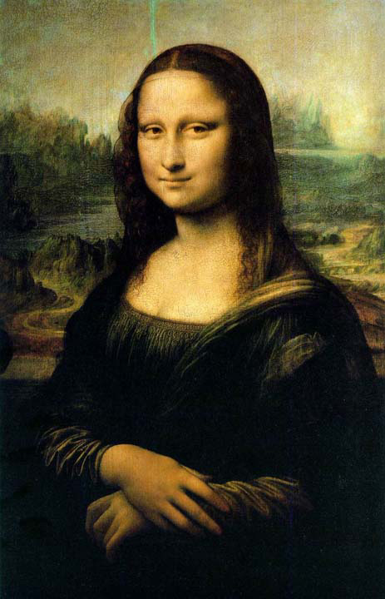
Image #1
Is this art? Why or why not? What elements does it have or not have?
Mona Lisa, Leonardo Da Vinci

Slide 9
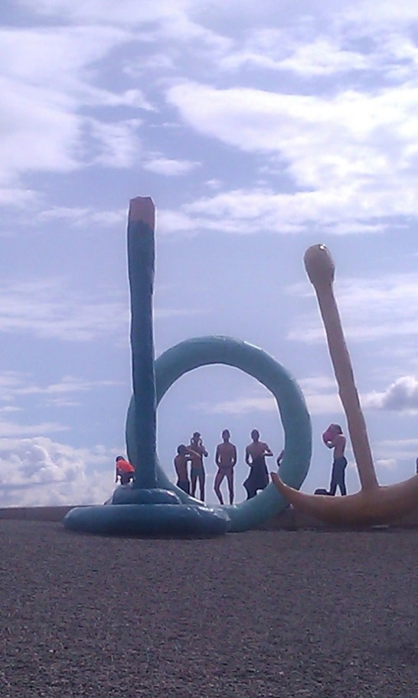
Image #2
Is this art? Why or why not? What elements does it have or not have?
Image credit: Taina Kanerva

Slide 10
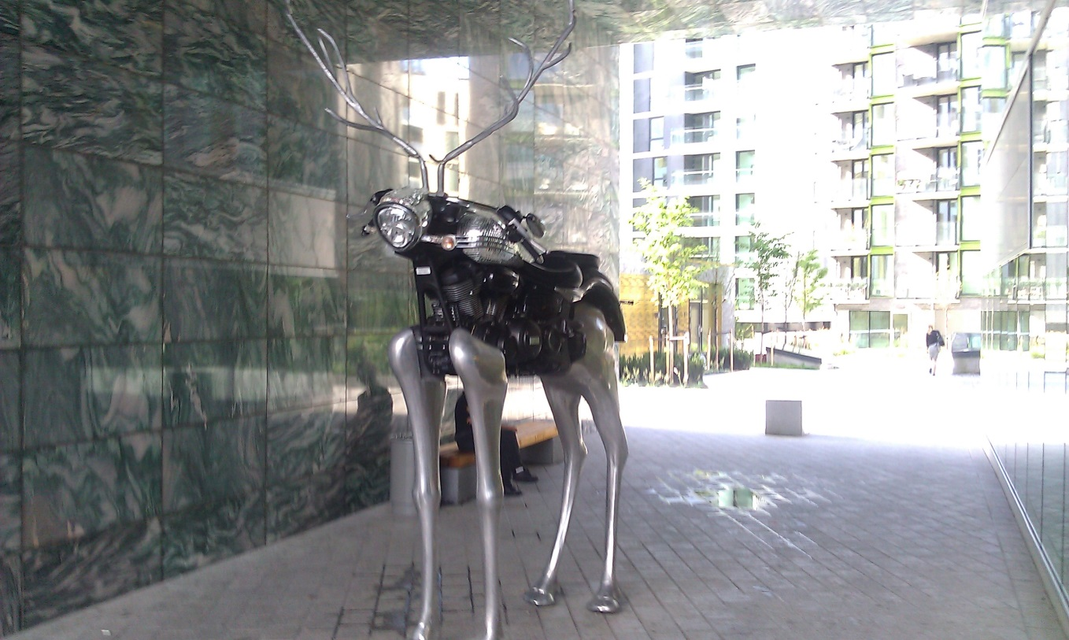
Image #3
Image credit: Taina Kanerva
Is this art? Why or why not? What elements does it have or not have?

Slide 11
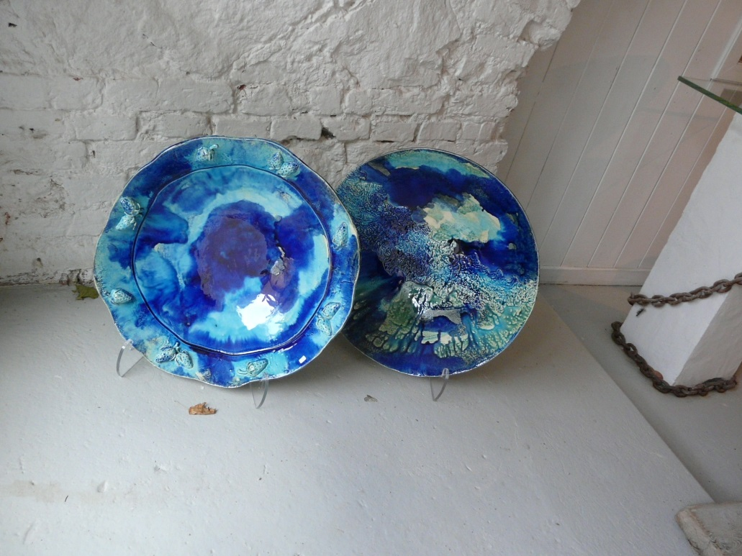
Image #4
Is this art? Why or why not? What elements does it have or not have?
Image credit: Taina Kanerva

Slide 12
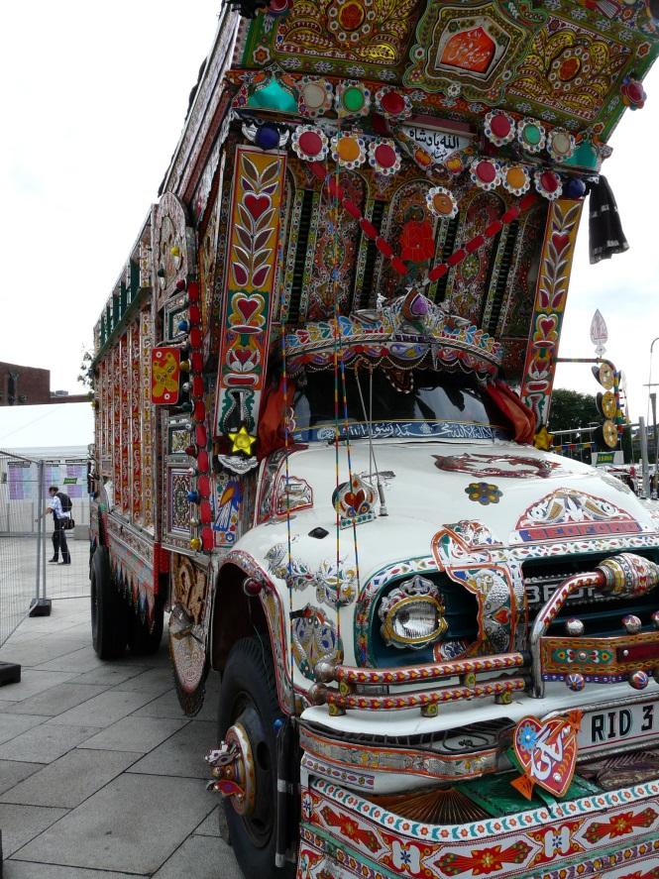
Image #5
Is this art? Why or why not? What elements does it have or not have?
Image credit: Taina Kanerva

Slide 13
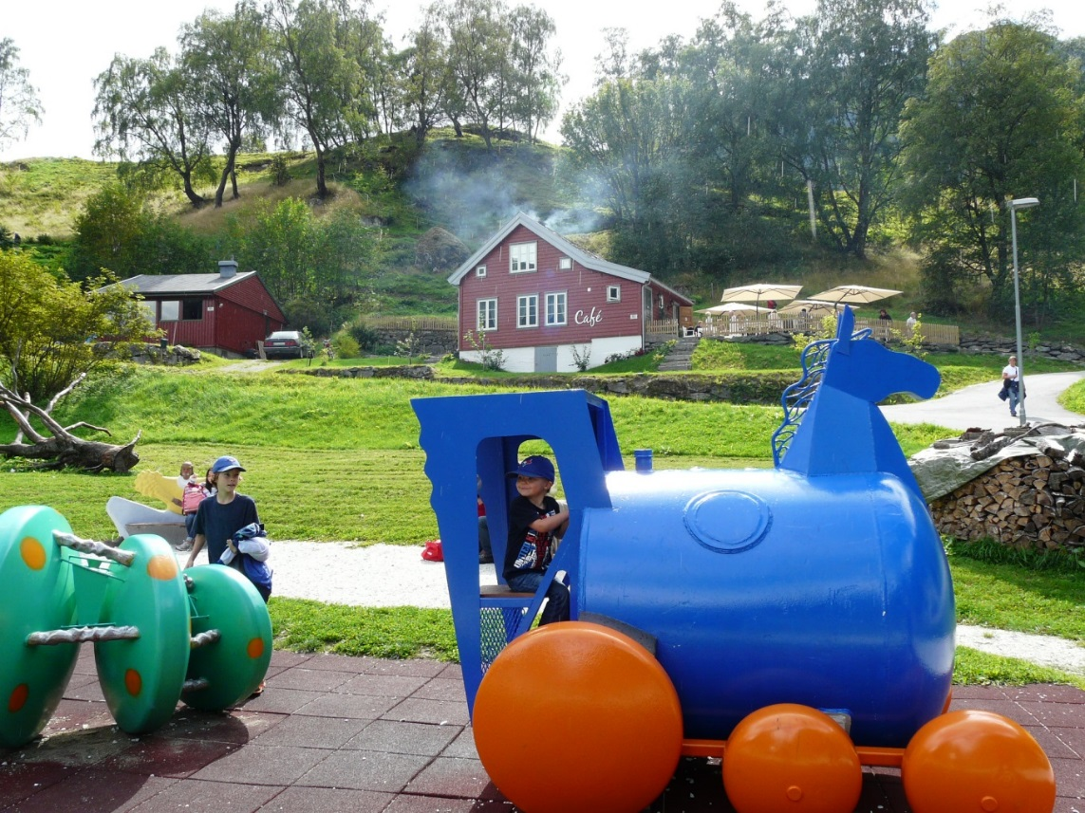
Image #6
Is this art? Why or why not? What elements does it have or not have?
Image credit: Taina Kanerva

Slide 14
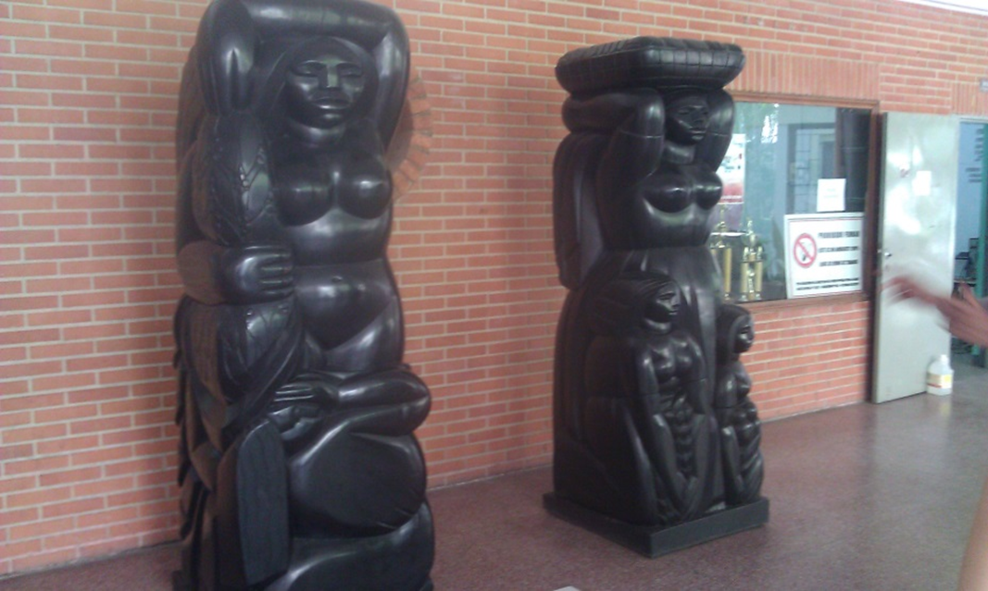
Image #7
Image credit: Taina Kanerva
Is this art? Why or why not? What elements does it have or not have?

Slide 15
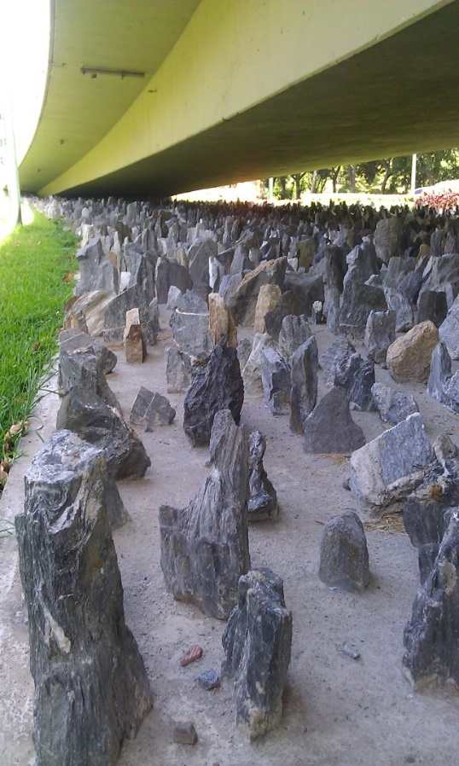
Image #8
Is this art? Why or why not? What elements does it have or not have?
Image credit: Taina Kanerva

Slide 16
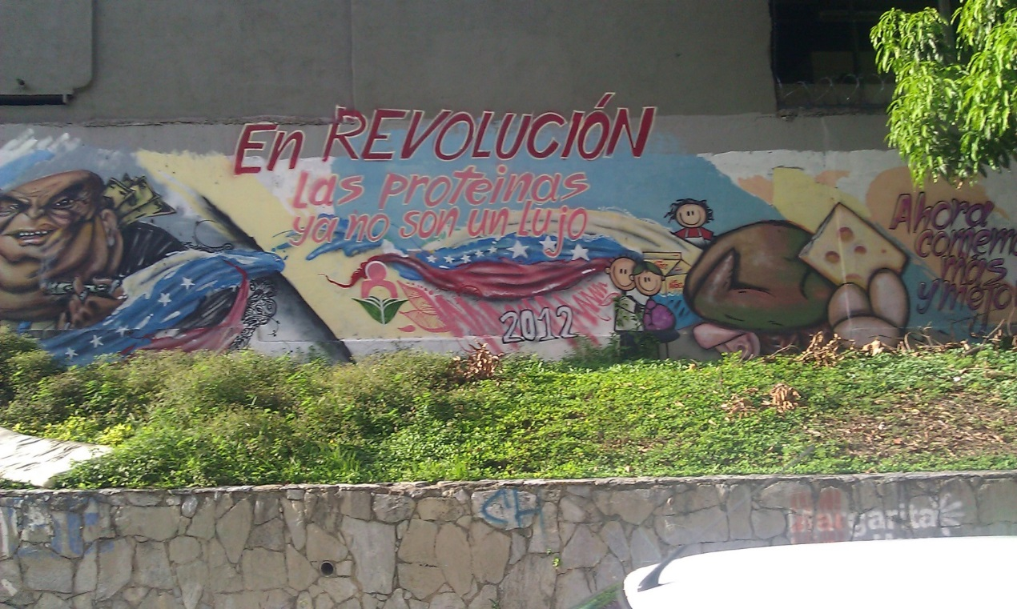
Image #9
Image credit: Taina Kanerva
Is this art? Why or why not? What elements does it have or not have?

Slide 17
Philosophy of art

Slide 18
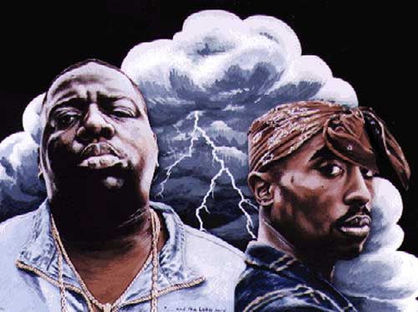
Plato (428/427 or 424/423 – 348/347 BCE)
Plato felt that since we don’t use reason to create art, art has little value.
Plato felt art was harmful because it intensified emotions, and actions, in socially harmful ways. (inside out thinking)
He wanted to censor music and poetry.
What would Plato think about the impact of the art created by Tupac and Biggie?
Was it good for society? Can you think of other examples that would support his position?
Image Credit: http://allhiphop.com/2012/03/06/hip-hop-rumors-biggies-unheard-tupac-diss/

Slide 19
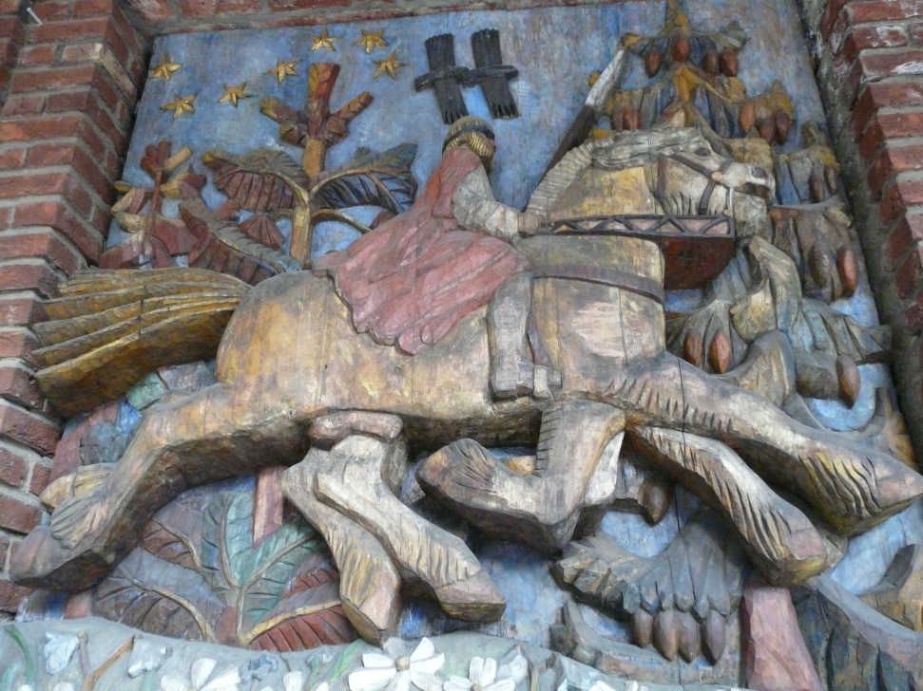
Aristotle (384 – 322 BC)
Aristotle felt art could provide insight into human existence.
What people create tells us something about humanity.
He felt we should keep and protect art as it will provide keys to other civilizations.
Art is an imitation of life (outside in thinking).
What might this famous piece of art tell us about humanity?
Image credit: Taina Kanerva

Slide 20
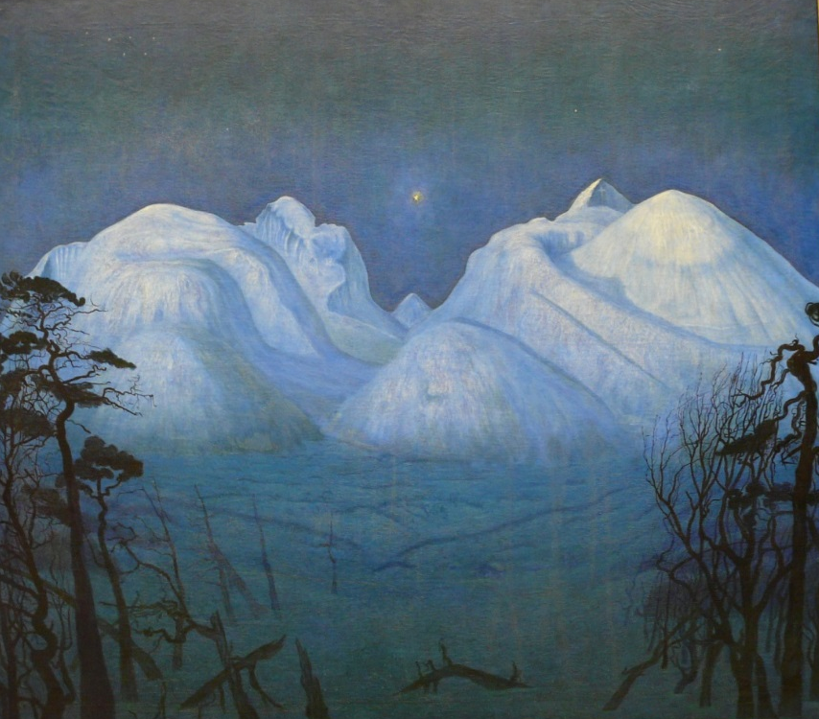
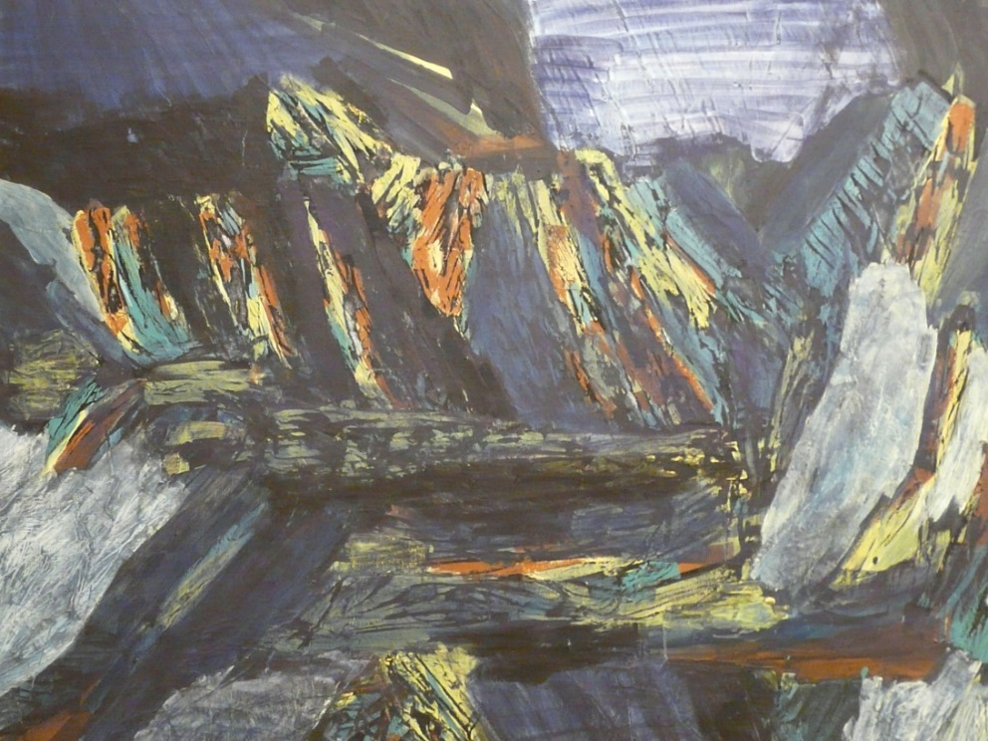
Moonlight Fjord, Image Credit: Taina Kanerva
Moonlight Fjord, Image Credit: Taina Kanerva
“When we make new music we don’t just record rain. We invent new sounds. Yet people have trouble accepting painting that does not look like nature.. Why is it okay with music but not painting?”
Pat, AGO tour guide, Dec 2013

Slide 21
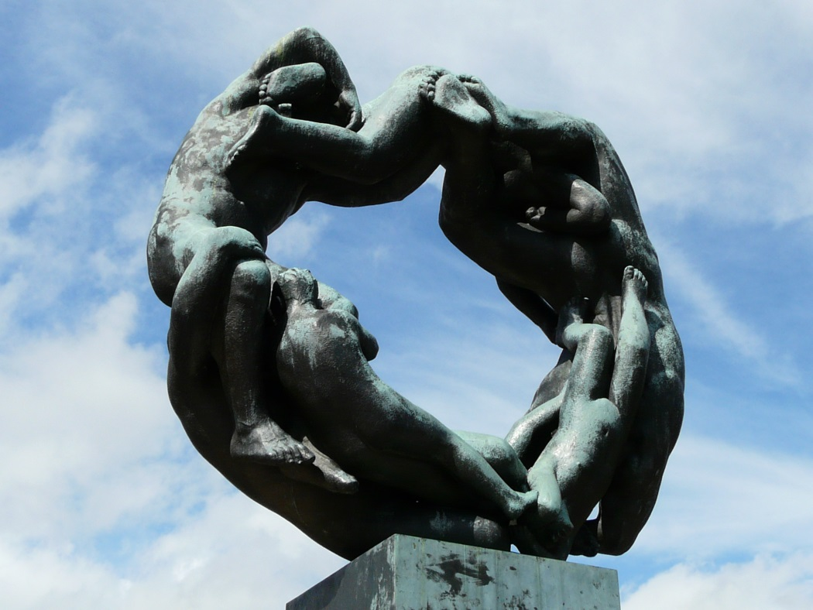
Oscar Wilde 16 October 1854–30 November 1900
In contrast to Plato, Wilde believed that art has no specific influence or instructional purpose.
Art should be created for art’s sake.
“A work of art is useless as a flower is useless. A flower blossoms for its own joy.”
What would Plato think about this piece of art? Do you agree with Plato or Oscar Wilde?
Vigeland - The Wheel of Life (lijshjulet)
Image Credit: Taina Kanerva

Slide 22
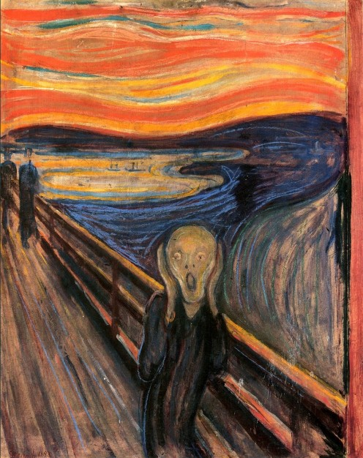
Immanuel Kant 22 April 1724–12 February 1804
Kant believed that good art must be aesthetically pleasing (called Aestheticism).
He felt that we have three types of aesthetic judgements. The first two are based on personal connection.
1) The Agreeable–based on our senses eg/ the taste of food.
Edvard Munch–The Scream
What would Kant say about this piece? It sold for $120 million in 2012.

Slide 23
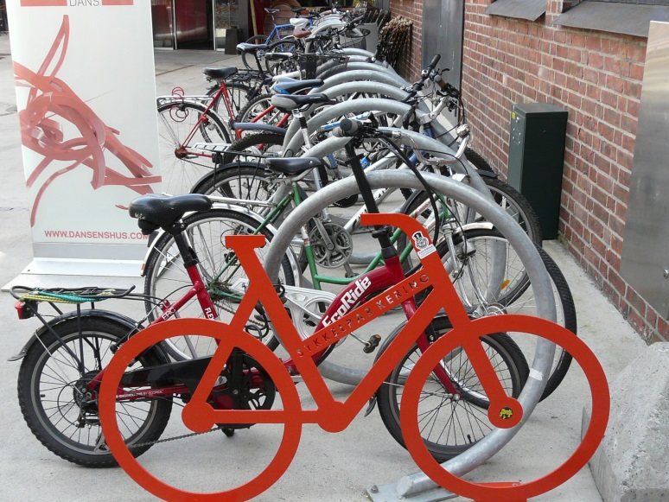
2) The Good–based on function eg/ this jacket keeps me warm.
3) The Beautiful–not based on personal purpose or pleasurable sensations it brings about. It is universal.
Good art is beautiful and to appreciate it we must be disinterested in our personal connection. We must not judge it with our emotions.
Image Credit: Taina Kanerva
Would everyone call this art? Is a bike lover more likely to enjoy this “art”? If we remove our personal connection to bikes would we describe this as art?

Slide 24
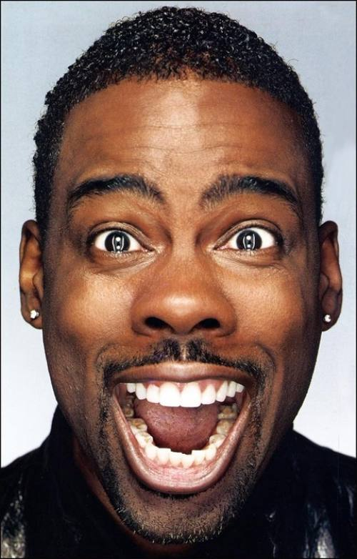
Leo Tolstoy 1828-1910
Rejected Kant’s idea that art must be aesthetically pleasing.
He felt the sole purpose is to convey emotion.
He felt that if everyday people cannot understand the emotion then it is not good art.
Image Credit:
http://rollingout.com/photos/celebrity-photos-photos/comedian-chris-rock-turns-49/#1
According to Tolstoy, would Chris Rock qualify as an artist?

Slide 25
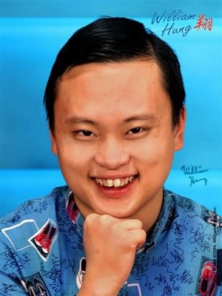
Idealist theory
R.G. Collingwood felt that art must have no practical purpose otherwise it becomes craft. e.g./ a quilt keeps you warm thus it is not art.
A work can be judged by the degree to which the artist’s intended emotion is communicated.
It is good if it makes the observer share the same emotion as the creator. It is about an honest authentic creation.
Image Credit: http://www.williamhung.net/bio.html
What would Collingwood think about William Hung? Would Tolstoy agree?
https://www.youtube.com/watch?v=9RrLQUN8UJg

Slide 26
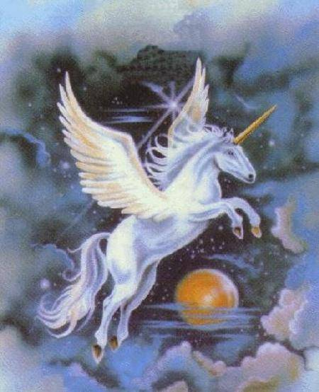
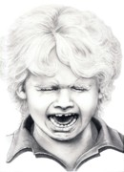
Which piece makes you feel the artist’s intended emotion?
Image Credit:
http://www.unicornlady.net/Gallery/images/9-2/winged_unicorn_nmbr_I.jpg
Image Credit:
http://fineartamerica.com/images-small/cry-
baby-murphy-elliott.jpg

Slide 27
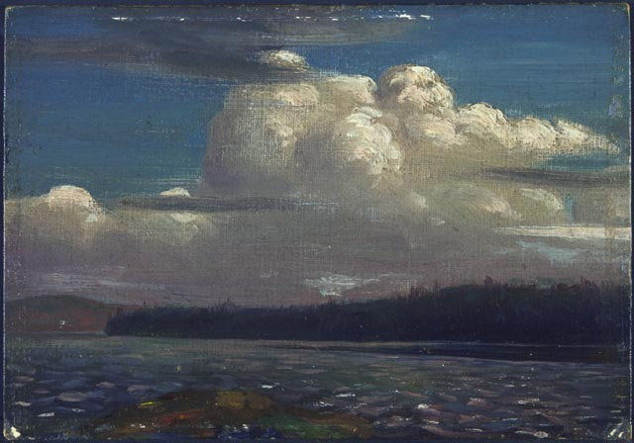
Aesthetic emotion
Clive Bell’s “significant form theory” evaluates two things:
How the elements within a work of art are combined (eg. Beauty) AND
How work produces an aesthetic emotional reaction in the spectator.
Thunder Cloud, 1912
Tom Thomson Bequest of Dr. J.M. MacCallum, Toronto, 1944 National Gallery of Canada (no. 4708)
http://www.gallery.ca/en/see/collections/artwork.php?mkey=2180

Slide 28
Aesthetics & appreciation
David Hume – felt that some people have a greater aptitude for certain kinds of art and therefore their opinions give them more credibility.
We must leave the assessment of good art versus bad art up to the experts. For example, American Idol, The Voice etc.
Image Credit: http://www.simoncowellonline.com/photos-2013-2/4579198926
Should we listen to Simon Cowell’s opinions about music because he is an expert?

Slide 29
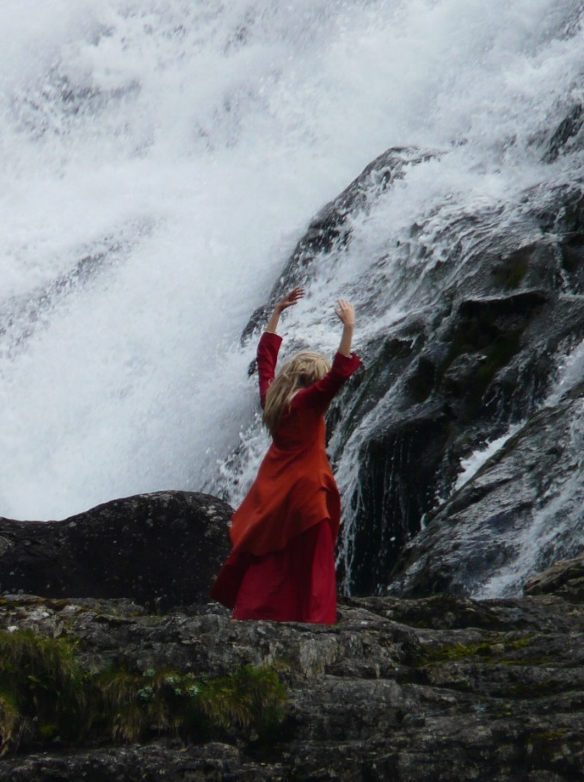
The Institutional Theory
Art in one culture may not be in another.
Experts within the culture have the authority to define a work of art.
Can a music critic from Prince Edward Island accurately review a Norwegian Dance?

Slide 30
Which culture would understand each piece of art?
Langt nord, i fjello
www.youtube.com/watch?v=8tsNMyyTL2s&list=PLnOSH5j1sQh-fsU47kzcB3K6IXLwnu3Fx
como no voy a decir - luis silva (llanos venezolanos)
www.youtube.com/watch?v=6Ptjedvauw8&list=PL701C183084AC80FB

Slide 31
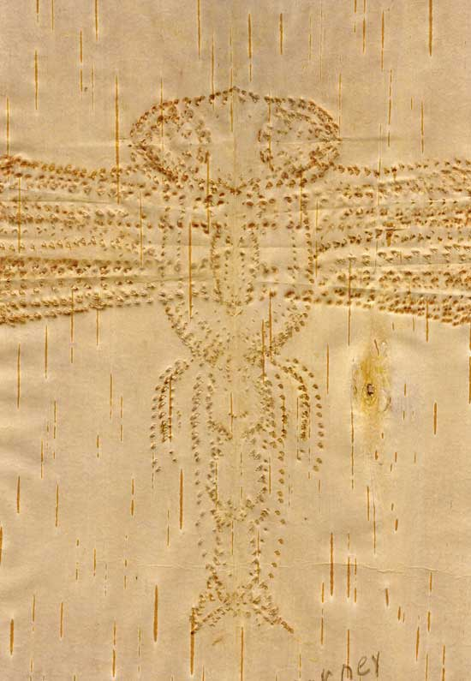
Ludwig Wittgenstein
Felt it is not enough to say we like or dislike a piece of art.
We must have some knowledge in order to appreciate it.
This could involve understanding the context, the culture or the process.
This piece of art was created using an ancient Aboriginal Art form. It was created by biting birch bark with your teeth.
https://www.youtube.com/watch?v=bFJaa9ndAts

Slide 32
Wittgenstein continued
We have to know something about painting to appreciate a painting or about music to appreciate a song.
Wittgenstein feels that we are mostly limited by language. How would you explain what rap sounds like to someone who has grown up in a rain forest?

Slide 33
Verbos irregulares:
Estos son unos verbos que, a paso de tortuga, Yo conjugo, Tú conugas, Él conjuga…
Como sin garantías todo el mundo se inhibe Yo no escribo, Tú no escribes Él no escribe
Pues de escribir las cosas que uno tiene en el seso Yo voy preso, Tú vas preso Él va preso
We have to know something about painting to appreciate a painting or about music to appreciate a song.
This is a poem of the late Venezuelan poet Aquiles Nazoa. It is considered a Venezuelan classic.

Slide 34
These are some verbs that, slow like a turtle
I conjugate You conjugate He conjugates
And since everyone is afraid with the lack of constitutional rights I don’t write You don’t write He doesn’t write
For if one writes all the thoughts under the veil I go to jail You go to jail He goes to jail
Is it easier to judge this poem now that it is in English?
What is the connection to Wittgenstein?

Slide 35
Discussion questions
Which of the philosophies on art do you feel best suits your perception? Why?
Which philosophy of art do you feel is best reflected in today’s society? Explain your choice.
How does our view on art influence our view of the world?
Revisit your first definition of art? Has it changed? If so how and why?

Slide 36
References
Images:
The Scream, Edvard Munch
The Scream - 1893 - oil, tempura, and pastel on cardboard. The National Gallery, Oslo, Norway
Retreived from: http://www.popspotsnyc.com/The_Scream/Scream_1893.jpg
Chris Rock
http://rollingout.com/photos/celebrity-photos-photos/comedian-chris-rock-turns-49/#1
Simon Cowell
http://www.simoncowellonline.com/photos-2013-2/4579198926
William Hung
http://www.williamhung.net/bio.html
Poetry by Aquiles Nazoa
https://globalvoicesonline.org/2008/05/27/venezuela-the-poet-who-enjoyed-the-simple-things-in-life/

